Slide 1

CS223 Operating Systems
DEPARTMENT OF COMPUTER SCIENCE AND ENGINEERING

Slide 2

Syllabus
File Management: Overview, File Organization and Access, File Directories, File Sharing, Record Blocking.
I/O Management: I/O Devices, Organization of the I/O Functions, I/O Buffering, Disk Scheduling.
COMPUTER ENGINEERING AND TECHNOLOGY

Slide 3
File Management
Overview
Files are the central element to most applications
Desirable properties of files:
  Long-term existence
  Sharable between processes
  Structure
COMPUTER ENGINEERING AND TECHNOLOGY

Slide 4
Terms in common use when discussing files
1. Fields
  Basic element of data
  Contains a single value
  Characterized by its length and data type
2. Records
  Collection of related fields
  Treated as a unit
3. File
  Have file names
  Is a collection of similar records
  Treated as a single entity
  May implement access control mechanisms
4. Database
  Collection of related data
  Relationships exist among elements
  Consists of one or more files
COMPUTER ENGINEERING AND TECHNOLOGY

Slide 5
File System
The File System is one of the most important part of the OS to a user
Concerned with secondary storage
File systems also provide functions which can be performed on files:
  Create
  Delete
  Open
  Close
  Read
  Write
COMPUTER ENGINEERING AND TECHNOLOGY

Slide 6
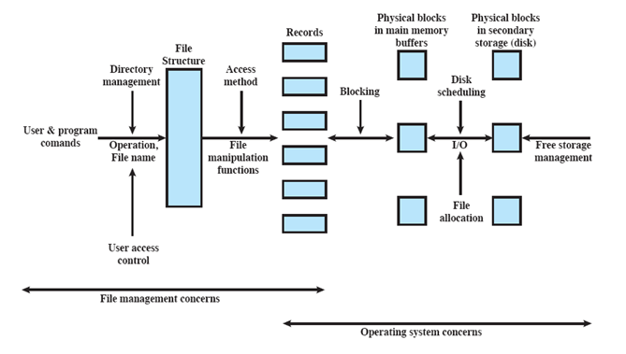
Elements of File Management
COMPUTER ENGINEERING AND TECHNOLOGY

Slide 7
File Organization
Refers to the logical structuring of records
Determined by the way in which files are accessed
Important criteria while choosing a file organization:
  Short access time
  Ease of update
  Economy of storage
  Simple maintenance
  Reliability
File Organization Types
Many exist, but usually variations of:
  Pile
  Sequential file
  Indexed file
  Direct or hashed file
Many exist, but usually variations of:
  Pile
  Sequential file
  Indexed sequential file
  Indexed file
  Direct or hashed file
COMPUTER ENGINEERING AND TECHNOLOGY

Slide 8
File Organization
Pile
Data are collected in the order they arrive
No structure
Purpose is to accumulate a mass of data and save it
Records may have different fields
Record access is by exhaustive search
Sequential File
Fixed format used for records
Records are the same length
Key field
  Uniquely identifies the record
  Records are stored in key sequence
COMPUTER ENGINEERING AND TECHNOLOGY

Slide 9
File Organization
Indexed File
Maintains the key characteristic of the sequential file:
  records are organized in sequence based on a key field
  An index is added to the file to support random access
  Can use multiple indexes for different key fields
  May contain an exhaustive index that contains one entry for every record in the main file
  May contain a partial index
  When a new record is added to the main file, all of the index files must be updated
  Direct or Hash File
  Directly access a block at a known address
  Key field required for each record
  But there is no concept of sequential ordering
  Makes use of hashing on the key value
COMPUTER ENGINEERING AND TECHNOLOGY

Slide 10
File Directories
Contains information about files
  Attributes
  Location
  Ownership
Provides mapping between file names and the files themselves
A directory system should support a number of operations including:
  Search
  Create files
  Deleting files
  Listing directory
  Updating directory
COMPUTER ENGINEERING AND TECHNOLOGY

Slide 11
Directory Elements
  Basic Information
  File Name
  -Name as chosen by creator
  -Must be unique within a specific directory
  Address Information
  Volume -Indicates device on which file is stored
  Starting Address
  Size Used -Current size of the file in bytes, words, or blocks
  Size Allocated - Maximum size of the file
Access Control Information
Owner
  -Owner has control of this file & able to grant/deny access to other users and to change these privileges.
Access Permission
-Specifies read, write & execute permissions on the file for owner, group & others
COMPUTER ENGINEERING AND TECHNOLOGY

Slide 12
Directory Elements:
Usage Information
Date Created
Identity of Creator
Date Last Read Access
Identity of Last Reader
Date Last Modified
Identity of Last Modifier
Date of Last Backup
Current Usage
COMPUTER ENGINEERING AND TECHNOLOGY

Slide 13
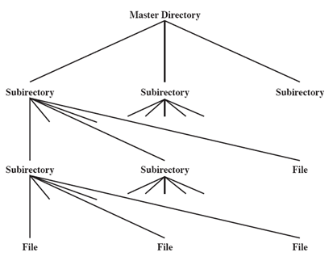
Hierarchical or Tree-Structured Directory
Master directory with user directories underneath it
Each user directory may have subdirectories and files as entries
Naming
Users need to be able to refer to a file by name
Files need to be named uniquely
Tree structure allows users to find a file by following the directory path
Duplicate filenames are possible if they have different pathnames
COMPUTER ENGINEERING AND TECHNOLOGY

Slide 14
File Sharing
In multiuser system, allow files to be shared among users
Two issues
  Access rights
  Management of simultaneous access
    -User may lock entire file when it is to be updated
    -User may lock the individual records during the update
    -Mutual exclusion and deadlock are issues for shared access
  User Classes
Owner - Usually the files creator, has full rights
User Groups - A set of users identified as a group
Others
COMPUTER ENGINEERING AND TECHNOLOGY

Slide 15
Record Blocking
Records are the logical unit of access of a structured file
  But blocks are the unit for I/O with secondary storage
Three approaches are common
  Fixed length blocking
  Variable length spanned blocking
  Variable-length unspanned blocking
COMPUTER ENGINEERING AND TECHNOLOGY

Slide 16
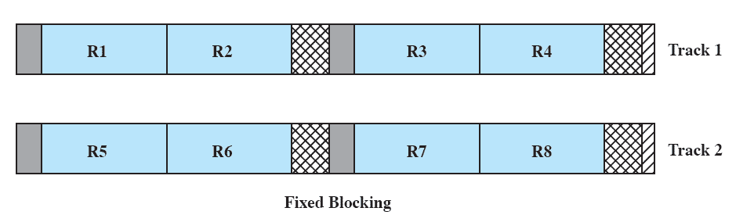
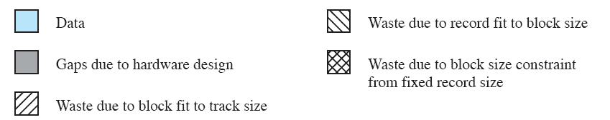
Fixed Blocking
Fixed-length records are used
Unused space at the end of a block is internal fragmentation
COMPUTER ENGINEERING AND TECHNOLOGY

Slide 17
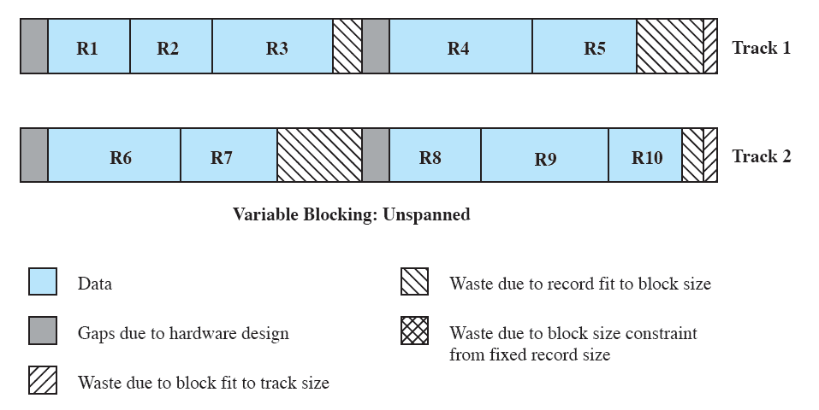
Variable-length un-spanned blocking
Uses variable length records without spanning
Wasted space in most blocks because of the inability to use the remainder of a block if the next record is larger than the remaining unused space
COMPUTER ENGINEERING AND TECHNOLOGY

Slide 18
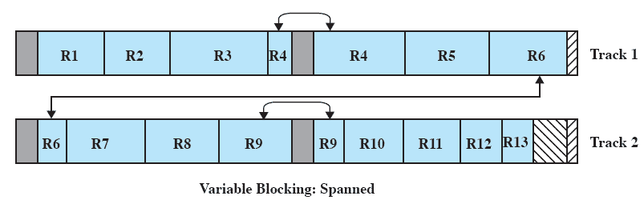
Variable Length Spanned Blocking
Variable-length records are used
Some records may span multiple blocks
Continuation is indicated by a pointer to the successor block
COMPUTER ENGINEERING AND TECHNOLOGY

Slide 19
I/O Management
  I/O Devices
  Organization of the I/O Function
  I/O Buffering
  Disk Scheduling
COMPUTER ENGINEERING AND TECHNOLOGY

Slide 20
Categories of I/O Devices
Three Categories:
  1. Human readable
Devices used to communicate with the user
  Video display, Keyboard, Mouse, Printer, etc
  2. Machine readable
Used to communicate with electronic equipment
  Disk drives, Sensors, Controllers, Actuators, etc
  3. Communications
Used to communicate with remote devices
  Modems, Digital line drivers, etc
COMPUTER ENGINEERING AND TECHNOLOGY

Slide 21
Differences in I/O Devices
Devices differ in a number of areas
  Data Rate - Massive difference between the data transfer rates of devices
  Application
  Complexity of Control - Complexity of the I/O module that controls the device. Eg. Disk is much more complex as compared to printer
  Unit of Transfer - Data may be transferred as a stream of bytes or characters (e.g., terminal I/O) or in larger blocks (e.g., disk I/O).
  Data Representation - Different data encoding schemes are used by different devices
  Error Conditions - nature of errors differ widely from one device to another
COMPUTER ENGINEERING AND TECHNOLOGY

Slide 22
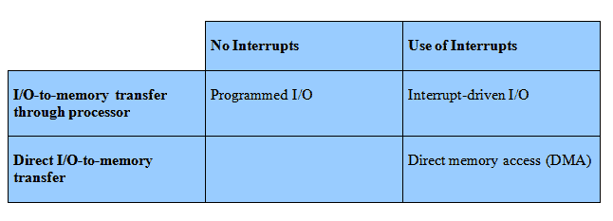
Organization of the I/O Function
Techniques for performing I/O
Programmed I/O
Interrupt-driven I/O
Direct memory access (DMA)
COMPUTER ENGINEERING AND TECHNOLOGY

Slide 23
Direct Memory Address
Processor delegates I/O operation to the DMA module
DMA module transfers data directly to or form memory
When complete, DMA module sends an interrupt signal to the processor
COMPUTER ENGINEERING AND TECHNOLOGY

Slide 24
I/O Buffering
Processes must wait for I/O to complete before proceeding
It may be more efficient to perform input transfers in advance of requests being made and to perform output transfers some time after the request is made.
Block-oriented Buffering
Information is stored in fixed sized blocks
Transfers are made a block at a time Eg. Used for disks
Stream-Oriented Buffering
Transfer information as a stream of bytes
Used for terminals, printers, communication ports, mouse, etc.
COMPUTER ENGINEERING AND TECHNOLOGY

Slide 25
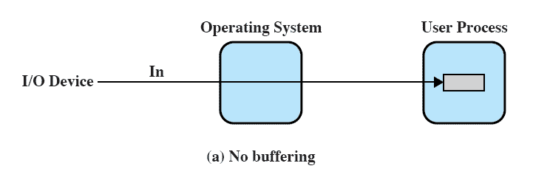
No Buffer
Without a buffer, the OS directly access the device as and when it needs
COMPUTER ENGINEERING AND TECHNOLOGY

Slide 26
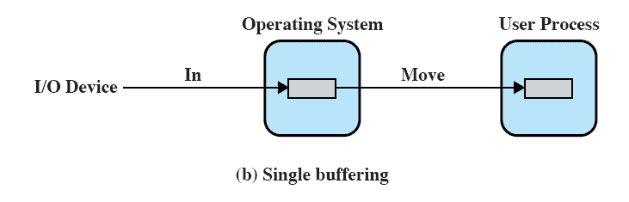
Single Buffer
Operating system assigns a buffer in main memory for an I/O request
COMPUTER ENGINEERING AND TECHNOLOGY

Slide 27
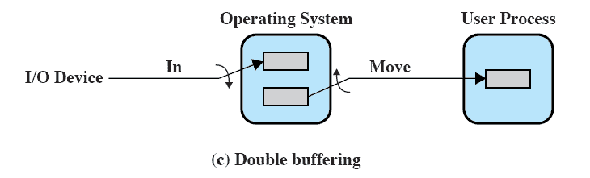
Double Buffer
Use two system buffers instead of one
A process can transfer data to or from one buffer while the operating system empties or fills the other buffer
COMPUTER ENGINEERING AND TECHNOLOGY

Slide 28
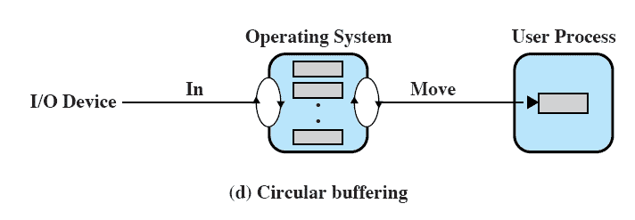
Circular Buffer
More than two buffers are used
Each individual buffer is one unit in a circular buffer
Used when I/O operation must keep up with process
COMPUTER ENGINEERING AND TECHNOLOGY

Slide 29
Buffer Limitations
Buffering smoothens out peaks in I/O demand
But with enough demand eventually all buffers become full and their advantage is lost
Buffering can increase the efficiency of the OS and the performance of individual processes.
COMPUTER ENGINEERING AND TECHNOLOGY

Slide 30
Disk Scheduling
When the disk drive is operating, the disk is rotating at constant speed
Positioning the Read/Write Head
Track selection involves moving the head to a specific track
Disk Performance Parameters
-Access Time is the sum of:
  Seek time: Time it takes to position the head at the desired track
  Rotational delay or rotational latency: The time its takes for the beginning of the sector to reach the head
-Transfer Time is the time taken to transfer the data.
COMPUTER ENGINEERING AND TECHNOLOGY

Slide 31
Disk Scheduling
Policies
To compare various schemes, consider a disk head is initially located at track 100.
  assume a disk with 200 tracks and that the disk request queue has random requests in it
The requested tracks, in the order received by the disk scheduler, are
  55, 58, 39, 18, 90, 160, 150, 38, 184.
COMPUTER ENGINEERING AND TECHNOLOGY

Slide 32
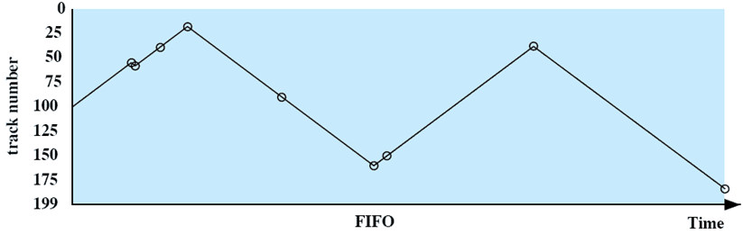
First-in, first-out (FIFO)
The requested tracks, in the order received by the disk scheduler, are
  55, 58, 39, 18, 90, 160, 150, 38, 184.
Processes requests sequentially in the order received
Fair to all processes
Approaches random scheduling in performance
COMPUTER ENGINEERING AND TECHNOLOGY

Slide 33
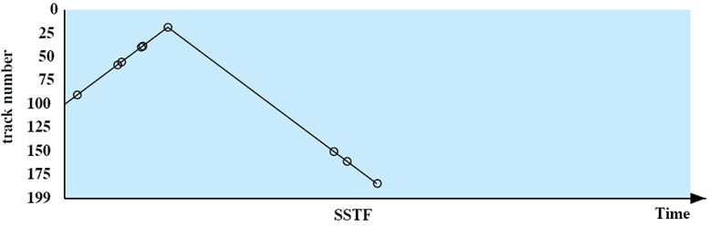
Shortest Service Time First
The requested tracks, in the order received by the disk scheduler, are
  55, 58, 39, 18, 90, 160, 150, 38, 184.
Select the disk I/O request that requires the least movement of the disk arm from its current position
Always choose the minimum seek time
COMPUTER ENGINEERING AND TECHNOLOGY

Slide 34
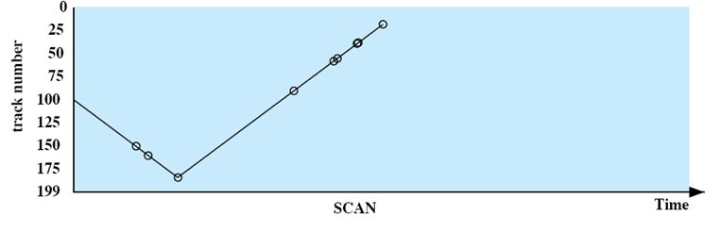
SCAN
The requested tracks, in the order received by the disk scheduler, are
  55, 58, 39, 18, 90, 160, 150, 38, 184.
Arm moves in one direction only, processing all outstanding requests until it reaches the last track in that direction & then the direction is reversed
COMPUTER ENGINEERING AND TECHNOLOGY

Slide 35
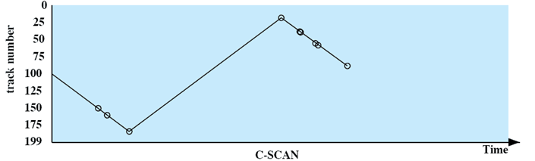
C-SCAN
The requested tracks, in the order received by the disk scheduler, are
  55, 58, 39, 18, 90, 160, 150, 38, 184.
Restricts scanning to one direction only
When the last track has been visited in one direction, the arm is returned to the opposite end of the disk and the scan begins again
COMPUTER ENGINEERING AND TECHNOLOGY

Slide 36
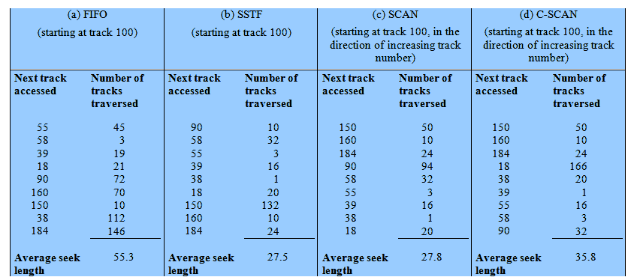
Performance Compared
Comparison of Disk Scheduling Algorithms
COMPUTER ENGINEERING AND TECHNOLOGY
Notes:
T

